Slide 1
TCS fusion imaging in the detection of cerebral white matter lesions
Cornelia Brunner
University Clinic Tulln, Department of Neurology, Austria

Slide 2
Disclosures

Slide 3
Introduction
Cerebral small vessel disease (CSVD)
causes about 20% of all strokes worldwide and increases the risk of future strokes
45% of cases with dementia, mood disturbance and gait disorders
diagnosis:
brain magnetic resonance imaging (MRI)
brain computed tomography (CT)
Notes:
Despite the devastating effects of CSVD the pathophysiology remains uncertain. functional and structural abnormalities of the cerebral microcirculation (arterioles, capillaris, veins)
CSVD – increased permeability of Blood brain barrier – enlargement of Virchow Robin space, WML, Microbleeds, lacunar infarcts. the increases permeability may result in an elevatetd activation of Macrophagen und Monocytes and endothelial cells.

Slide 4
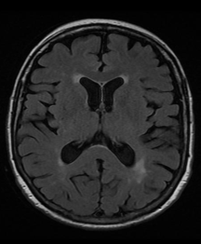
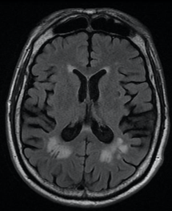
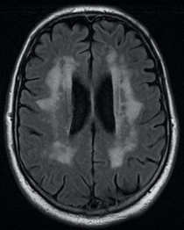
Introduction
Fazekas grading scale (Grade I-III)¹
Grade I
Grade II
Grade III
MRI, FLAIR
MRI, FLAIR
MRI, FLAIR
(¹Fazekas F 2002)

Slide 5
Why Ultrasound in CSVD?
increasing popularity of US in neurology
cheap
increasing imaging quality (very high imaging resolution)
widley available
non-radiative
easily repeatable - anytime
evaluation of structures in real time
high spacial resolution

Slide 6
Limitations of conventional Ultrasound
CT/MRI – great antatomic clarity
transcranial B-mode ultrasound (US) – bone window
US imaging planes hardly correspondes with the classical axial, coronal or sagittal radiological imaging planes
US is a „free hand“ technique
comparability of results between different sonographers
-> need for new imaging modalities
Notes:
imaging has limitations compared to non-bedside techniques like CT or MRI
Imaging planes: on the other hand, comparison and correlation of findings between different diagnostic modalities is an essential requierement for diagnosis, planning therapy or folllow up.
Free hand technique: countless options in choosing an individual insonsation plane, imaging of exactly the same region or point of interest during a reexamination can be very difficult or even impossible – therefore it is importan to define certain insonation planes

Slide 7
Fusion Imaging
Using Ultrasound fusion imaging is a relatively novel approach to evaluate brain tissue
Advantage: combination of real-time benefits resulting from US and anatomic clarity of CT/MRI images
Assits understanding the sometimes difficult interpretation of US images
Overlaying of two images, borders, shape and location of anatomic structures
Notes:
Ultrasound fusion imaging is a novel approach to evaluate brain tissue

Slide 8
Procedure and Technical Requirements
Pre-aquired MRI/CT scan of the brain (FLAIR sequence)
MRI/CT scans (DICOM format) are transferred to the US machine equipped with navigation software
generation of a homogeneous 3D images
Probe: sector transducer with an operating frequency of 2.0–3.5 MHz (variable band phased array: 4-1 MHz)
electromagnetic tracking system – transmitter, small receiver
registration (internal/external markerpoints)
Notes:
The virtual naviagation system processes every slice, taking into account the slice thickness and spacing
3D image – showing the three orthogonal planes

Slide 9
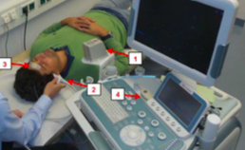
External/Internal markerpoints
MRI/CT scan and US image are displayed simultanously in the same plane
for calibration of image fusion – point registration is performed by placing the curser at the same anatomic structure (e.g. outer/inner corner of the eye, wing of the nose)
after point and plane registration electromagnetic tracking-based fusion imaging of real-time US can be performed
(Schreiber,2015)
Notes:
internal anatomic landmarks

Slide 10
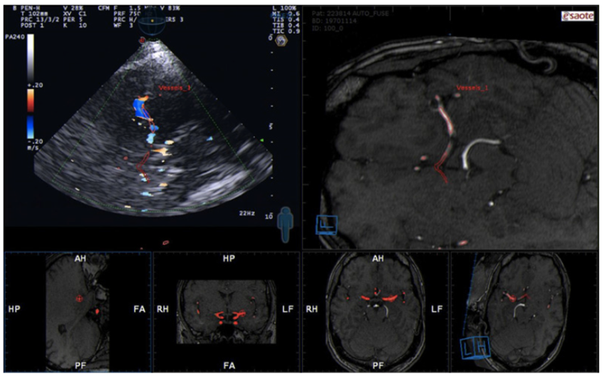
Matching
(Schreiber,2015)

Slide 11
Subjects
48 patients were screened
8 cases (7 in WMLs group, 1 in normal MRI group) had missing temporal bone windows and were excluded
29 patients showed vascular WMLs of variable degree quantified according to Fazekas grading scale (n=13 °I; n=9 °II; n=7 °III)
11 subjects without WMLs on MRI
Only images with reproducible clear anatomical landmarks per localization were included, therefore 233 localizations (161 with WMLs, 72 with normal MRI findings) were identified for further evaluation
unpublished data – do not copy or distribute

Slide 12
Hypothesis
Are the WMLs seen on MRI scans are vizualisable with transcranial Ultrasound?
Obtaining Inter-rater agreement: independent experienced ultra-sonographers who had been standardized instructed with representative US patterns and were blinded to patients´ diagnosis
unpublished data – do not copy or distribute

Slide 13
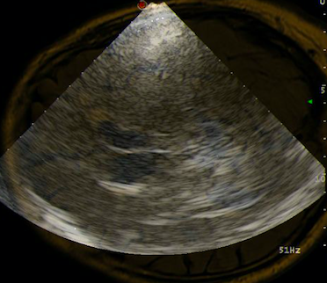
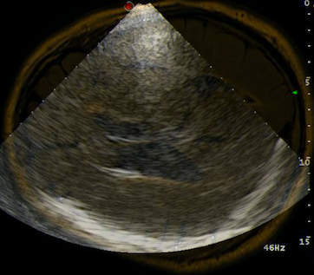
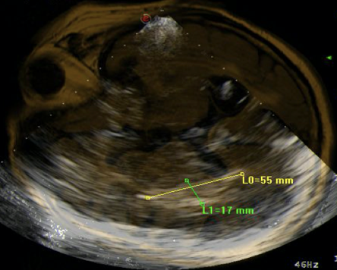
Fusion of MRI (FLAIR, DICOM Format) and US Images (B-Mode)
Anterior horn contralateral
Lateral ventricle contralateral
Posterior horn contralateral
unpublished data – do not copy or distribute

Slide 14
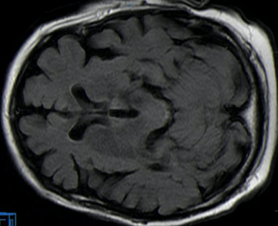
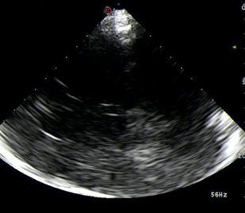
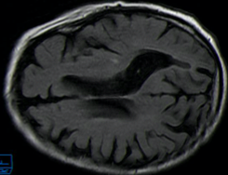
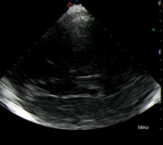
Subjects without WMLs
contralat. ant. horn
unpublished data – do not copy or distribute
contralat. lateral ventricle
FLAIR, MRI
B-Mode US

Slide 15
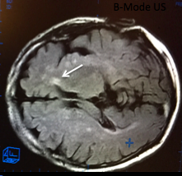
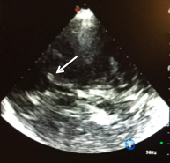
LE °I (Fazekas)
ipsilat., anterior horn
FLAIR, MRI
B-Mode US
unpublished data – do not copy or distribute

Slide 16
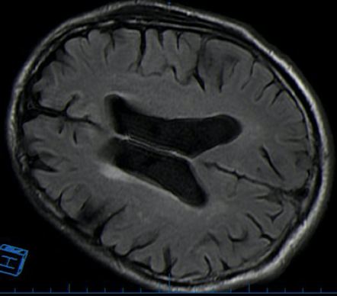
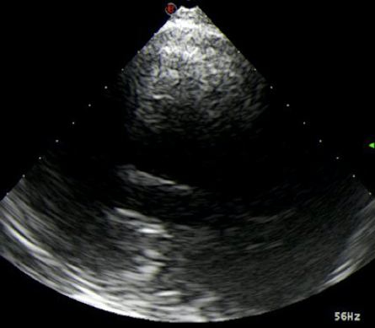
LE °I (Fazekas)
lat. ventricle, contralat.
unpublished data – do not copy or distribute
FLAIR, MRI
B-Mode US
unpublished data – do not copy or distribute

Slide 17
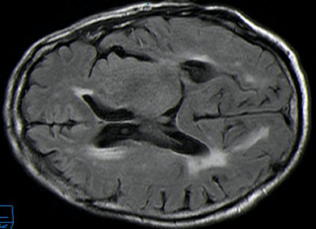
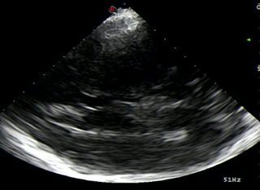
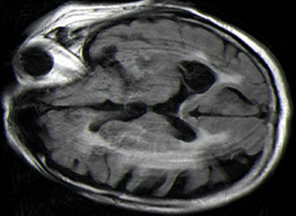
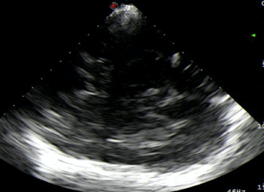
LE °II and °III (Fazekas)
LE II, post. horn, contralat.
unpublished data – do not copy or distribute
LE III, post. horn, contralat.
FLAIR, MRI
B-Mode US

Slide 18
Results – Detection Rate and IRA
Detection rate with and without WMLs with UFI per localization (blue) – 92% detection rate of WMLs.
Interrater agreement (orange) indicated an 86% agreement with an overall moderate strength of agreement (κ: 0.489, p <0.0005) for all localizations (n=233).
The highest accordance within raters was shown at the CPc; 92% (κ: 0. 645, p <0.0005) and at the ipsilateral frontal horn (FHi); 90% (κ: 0. 644, p <0.0005).
unpublished data – do not copy or distribute

Slide 19
Results – Detection rate depending on WMLs burden
UFI detection rate increases
with higher WMLs burden
LE°I: 85%
LE°II: 94%
LE°III: 97%
Merging MR images with US images during US examination increases the detection rate of periventricular WMHs on US images in B-Mode since the MR images help to find the lesions with US.
unpublished data – do not copy or distribute

Slide 20
Conclusion
We described to the best of our knowledge for the first time prospectively the ultrasound detection of cerebral white matter lesions corresponding to MRI lesions using B-Mode ultrasound fusion imaging technique
Sensitivity of cerebral WML ultrasound detection correlates with the degree of WML based on Fazekas Grading Scale on MRI
Further studies are necessary to evaluate the quantitative state of US detection of VLE (e.g. automatized evaluation systems)

